Slide 1
Archiver Appliance & Data Browser

Slide 2
Databrowser
Developed at ORNL by Kay Kasemir, Chen Xihui
The Data Browser is a trending tool. It can display the values of 'live' Process Variables (PVs) as well as historic data in a Stripchart-type plot.
Live Data
For each PV, the Data Browser collects 'live' samples from the control system and plots them over time.
Historic Data
The Data Browser queries archive data sources for historic samples to obtain data for time ranges 'before' the live sample buffer. You can configure one or more archive data source for each PV.
Notes:
The purpose of a product is to define application-specific branding on top of a configuration of Eclipse plug-ins. Minimally, a product defines the ID of the application it is associated with and provides a name, description, and unique ID of its own. A product also stores a table of additional properties, where the UI stores information such as the application window icon and the all-important blurb in the Help > About... dialog. It is quite possible to run Eclipse without a product, but if you want to customize the appearance of Eclipse for your particular application, you should define one.
Splash screens, window icons, welcome page, intro

Slide 3
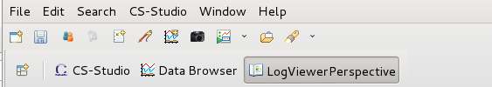
Data Browser - Getting Started
Running Data Browser
Menu: CSS → Trends → Data Browser
Toolbar: click on the open “Open New Data Browser Plot” icon in the toolbar
Context Menu*: Process Variable → Data Browser
Notes:
E: how to open databrowser
Menu
Toolbar
Add the the motor pv’s associated with the val, rbv, moving

Slide 4
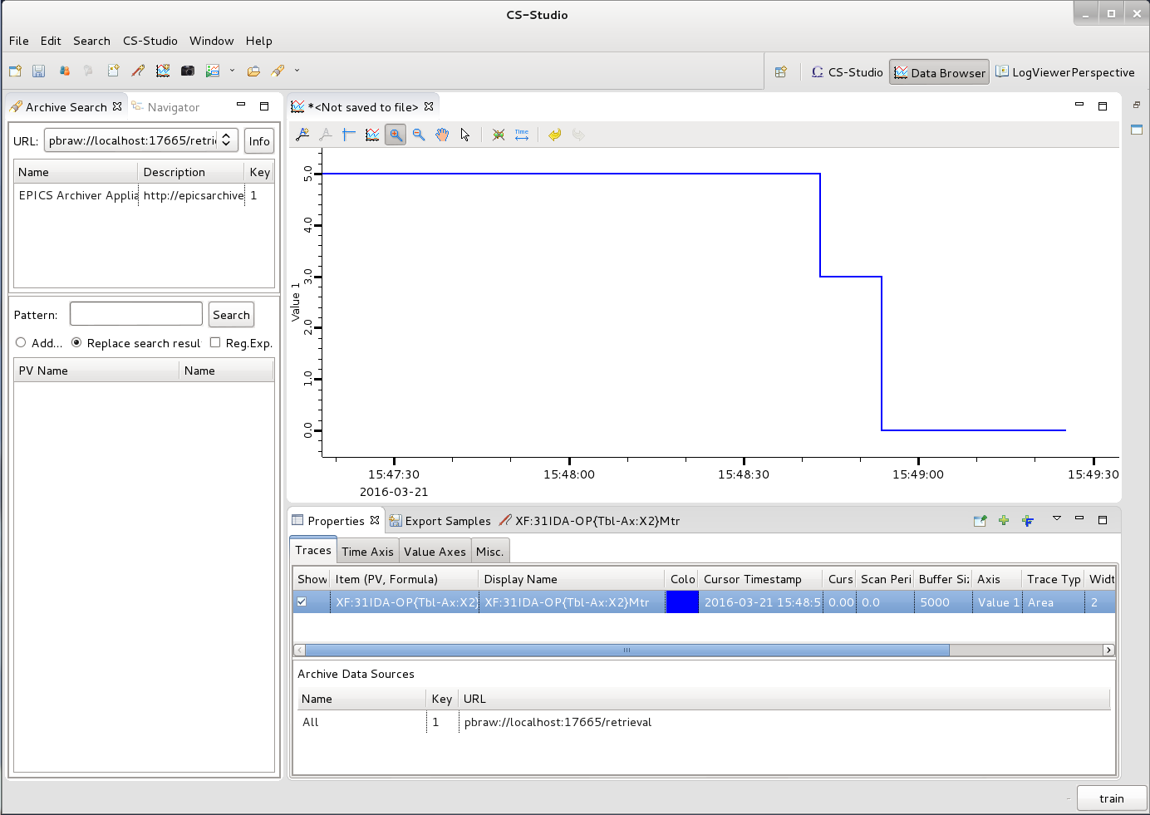
Data Browser Perspective
Open from context menu
Window→Open Perspective→Other Databrowser Perspective
Plot
Archive Search View
Properties View
Traces
Time Axis
Value Axis
Misc
Export Samples View

Slide 5
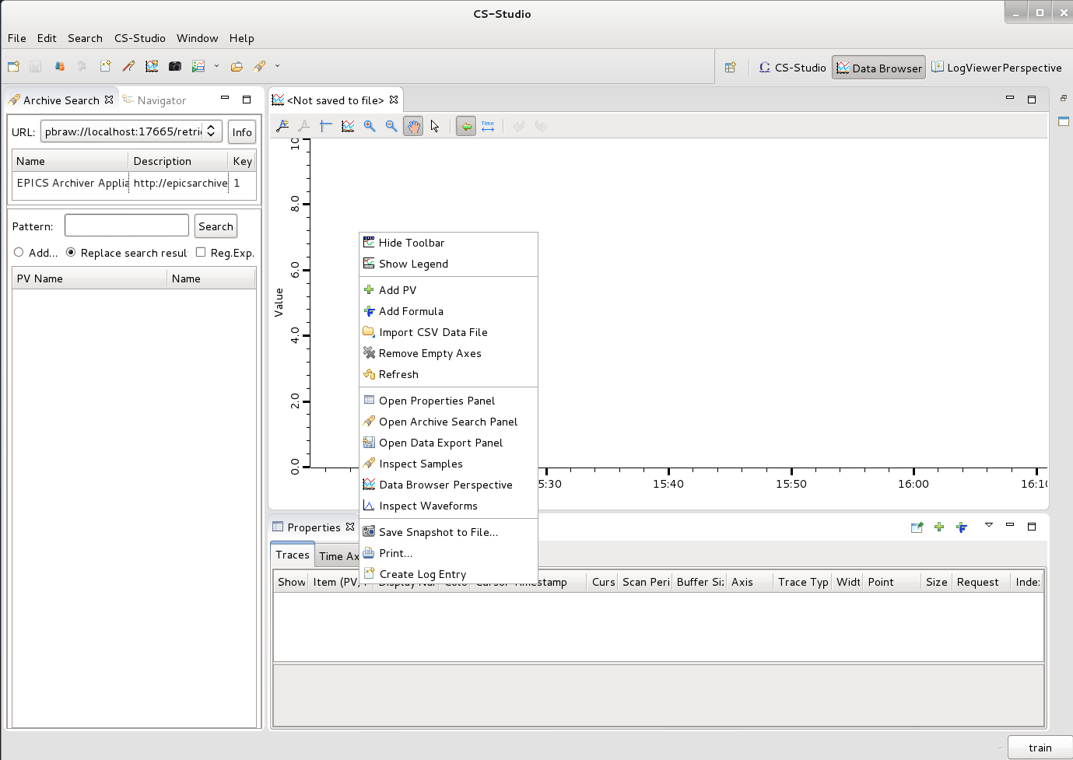
Adding PV’s
Right click → Add PV Name: XF:31IDA-OP{Tbl-Ax:X2}Mtr
Notes:
Databrowser screenshot – overview

Slide 6
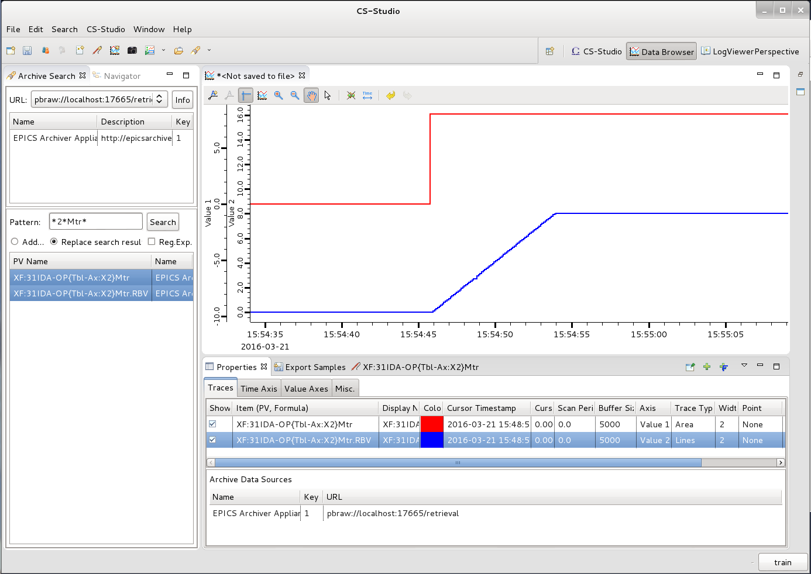
Searching for PV’s
Archive search view
Select Archive: default/current
Pattern : *2*Mtr*
Right click (open context menu) → Process Variable → Data Browser
Notes:
E:
Add PV’s
Modify the time axis
Combine value axis

Slide 7
Data Browser Details
Plot Toolbar
zoom in and out, rubber band zoom, scroll back and forth in time,….
Traces View
List of PV’s being displayed, the Visual characteristics of the traces associated with the PV’s, and list of Data sources
Time Axis View
Define start and end time of the plot in either relative or absolute terms
Value Axis View
Manage the Y Axis/Axes, i.e. colour, range,….
Notes:
Exercise
Play around a bit
Combine the SP and RB into one axis
Set the axis as fixed
Color
Time ranges
Save .plt file
Open .plt file

Slide 8
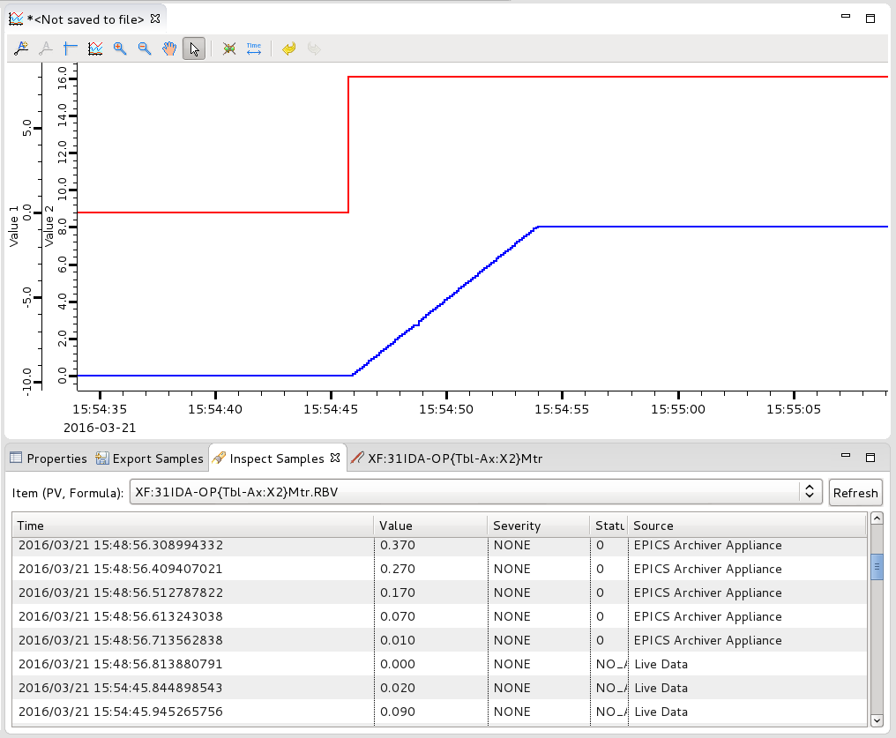
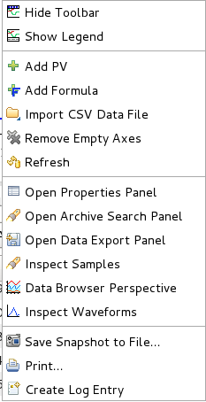
Data Browser Inspect samples
Allows inspection of pv values being plotted.
Context Menu → Inspect Samples
Notes:
Export data

Slide 9
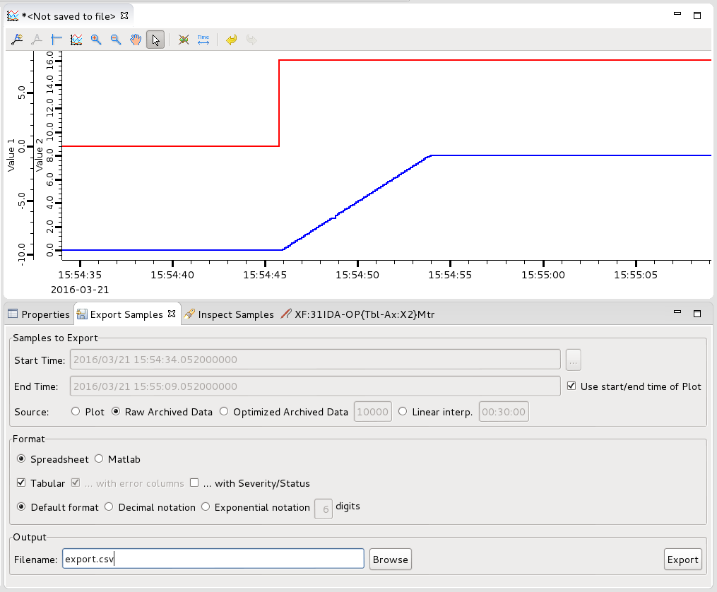
Data Browser Export
Samples to Export: Define the amount and the source of the data to be exported.
Format: Select the output format exported for the data.
Output: Select the output file.
Notes:
Export data

Slide 10
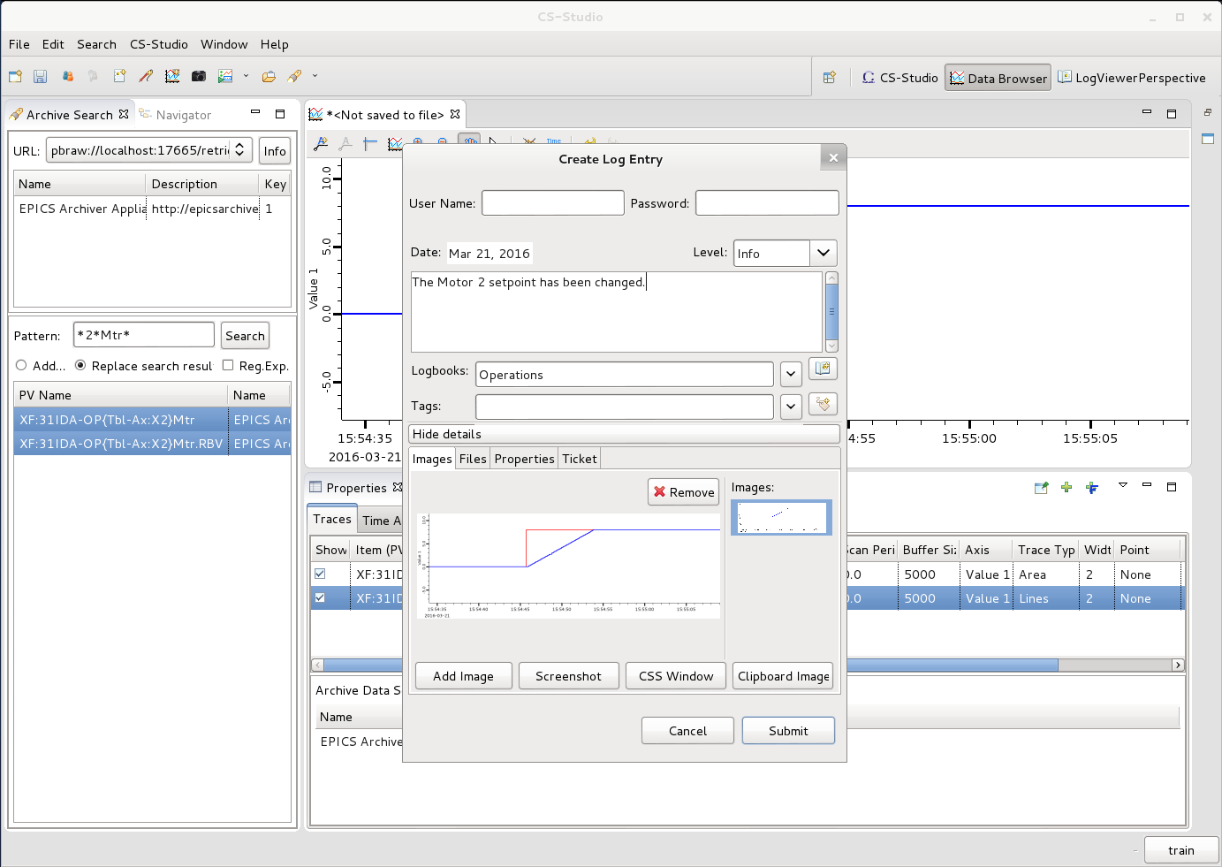
Create log entry
Context menu (right click) →
Create log entry
A log Entry dialog pre populated with appropriate data depending on which application you are making the log entry from
Username:
password:
Exercise:
Create a log entry, with some text and plot
Exercise:
Create a log entry with – text, plot and .plt file
Notes:
Create log Entry
Log entry with context

Slide 11
More Information
Help
Help → Help Contents → CSS Applications → Data Browser

Slide 12
Appliance Archiver

Slide 13
Motivation
The EPICS Archiver Appliance is an implementation of an archiver for EPICS control systems that aims to archive millions of PVs.
Ability to cluster appliances and to scale by adding appliances to the cluster.
Multiple stages and an inbuilt process to move data between the stages.
Focus on data retrieval performance.
Focus on zero oversight.

Slide 14
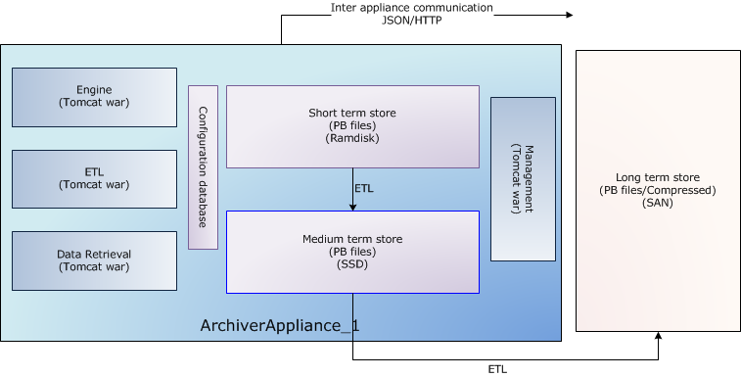
Appliance Archiver

Slide 15
Appliance Archiver pva services
pva
RPC
pva
RPC

Slide 16
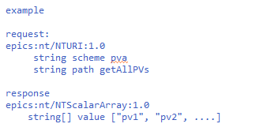
pvaMgmtService:getAllPVs
Get all the PVs in the cluster.
limit - An optional argument that specifies the number of matched PV's that are retured. If unspecified, we return 500 PV names.

Slide 17
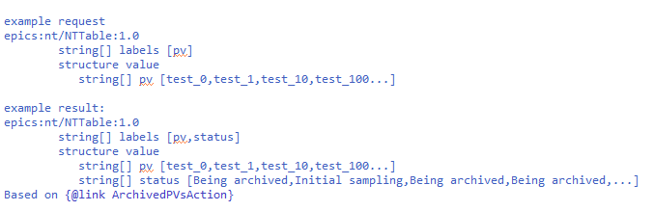
pvaMgmtService:archivedPVStatus
Given a list of PVs, determine those that are being archived.

Slide 18
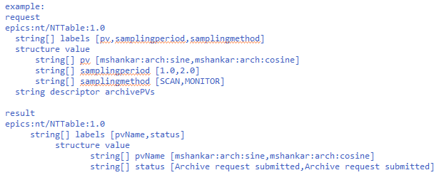
pvaMgmtService:archivePVs
Add one or more pvs to the archiver.
The requests for archiving pv's, the request consists of an NTTable with a list of pv's to be archived, optional attributes include sampling period and/or samplingmethod

Slide 19
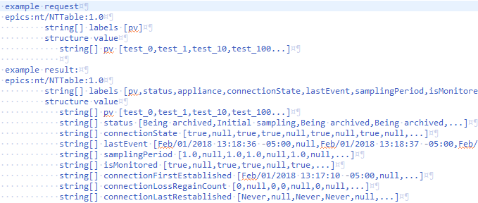
pvaMgmtService:PVStatus
Get the status of a PV.
pv - The name(s) of the pv for which status is to be determined.

Slide 20
pvaDataRetrievalService:getPVsData (under development)
request: epics:nt/NTURI:1.0 string scheme string path getPVsData
response: NTComplexTable string[] labels [] epics:nt/NTScalar:1.0[] value epics:nt/NTScalar:1.0 double value -10.0 alarm_t alarm int severity 0 int status 0 string message epics:nt/NTScalar:1.0 double value -9.8 alarm_t alarm int severity 0 int status 0 string message

